Slide 7
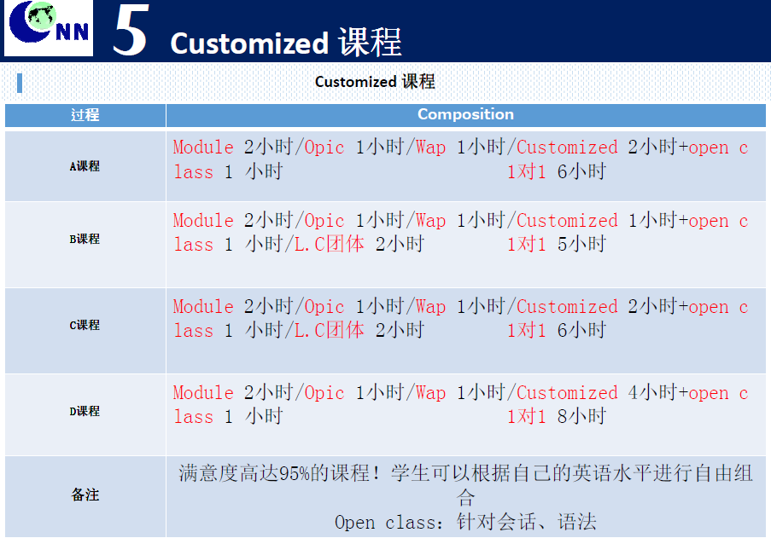
Open class (滿5人才加開)

